Slide 1

Deep Reinforcement Learning A short Introduction

Slide 2
Deep Reinforcement Learning A short Introduction
This is a Short Intro to DRL using (copy & paste) the following references:
Introduction to RL by David Silver http://www0.cs.ucl.ac.uk/staff/d.silver/web/Teaching_files/intro_RL.pdf https://www.youtube.com/watch?v=2pWv7GOvuf0&list=PL7-jPKtc4r78-wCZcQn5IqyuWhBZ8fOxT
Lex Fridman. MIT 6.S094: Deep Reinforcement Learning https://www.youtube.com/watch?v=MQ6pP65o7OM
Harini Suresh.MIT 6.S191 Lecture 6: Deep Reinforcement Learning https://www.youtube.com/watch?v=xWe58WGWmlk&t=362s
Fei Fei Li & Justin Johnson & Serena Young Lecture 14 | Deep Reinforcement Learning (Stanford Univ) https://www.youtube.com/watch?v=lvoHnicueoE

Slide 3
Deep Reinforcement Learning A short Introduction
Guest Post (Part I): Demystifying Deep Reinforcement Learning. Tambet Matiisen https://ai.intel.com/demystifying-deep-reinforcement-learning/
Human-level control through deep reinforcement learning by Bowen Xu https://www.teach.cs.toronto.edu//~csc2542h/fall/material/csc2542f16_dqn.pdf
Slides from Jiang Guo available at: http://ir.hit.edu.cn/~jguo/docs/notes/dqn-atari.pdf
Readings:
https://web.stanford.edu/class/psych209/Readings/MnihEtAlHassibis15NatureControlDeepRL.pdf

Slide 4
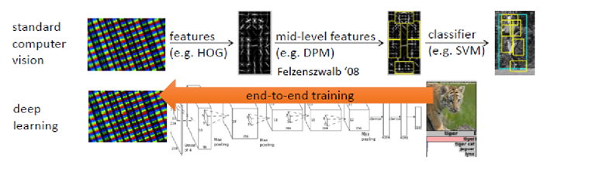
(in this course) at this point we have considered Deep Learning as:
End-to-end
REVOLUTION!

Slide 5
The QUESTION for today is:
To which degree we can teach systems to act, to perceive and act in this world from data?
Lex Fridman
MIT 6.S094: Deep Reinforcement Learning

Slide 6
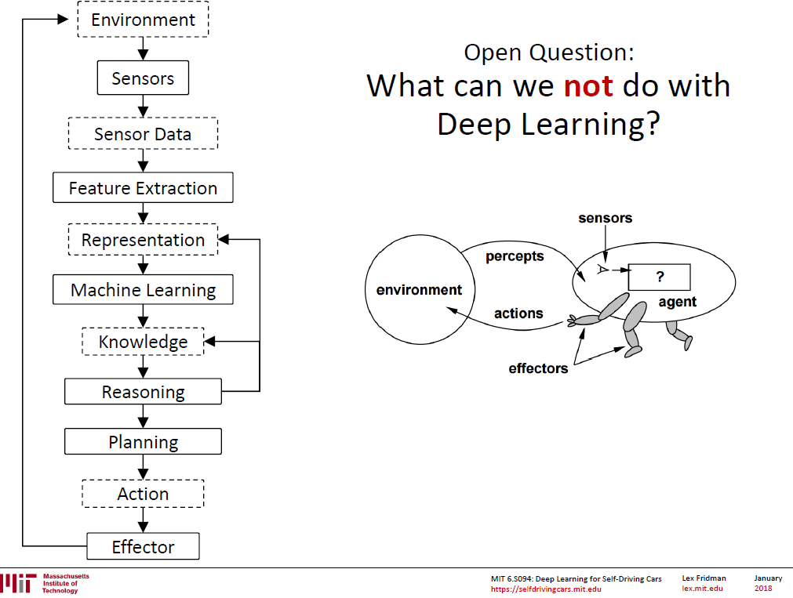

Slide 7
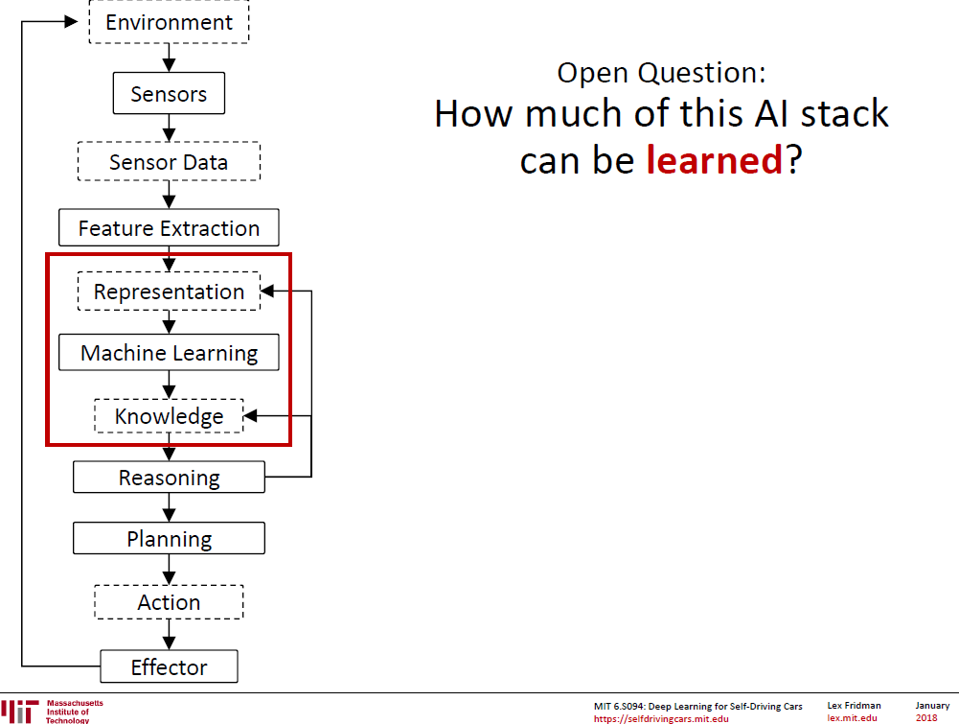

Slide 8
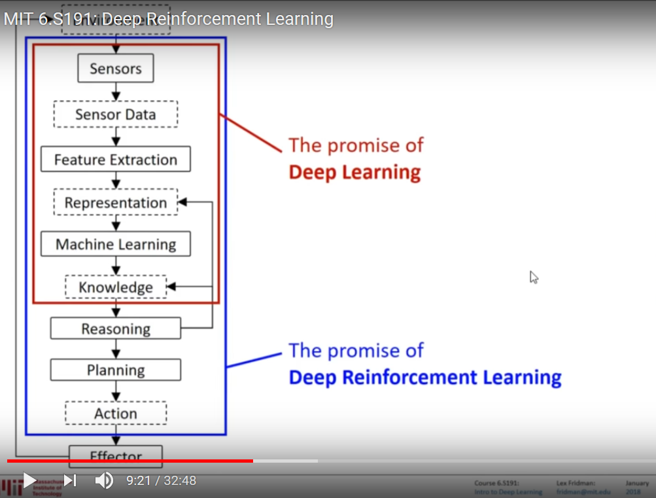

Slide 9
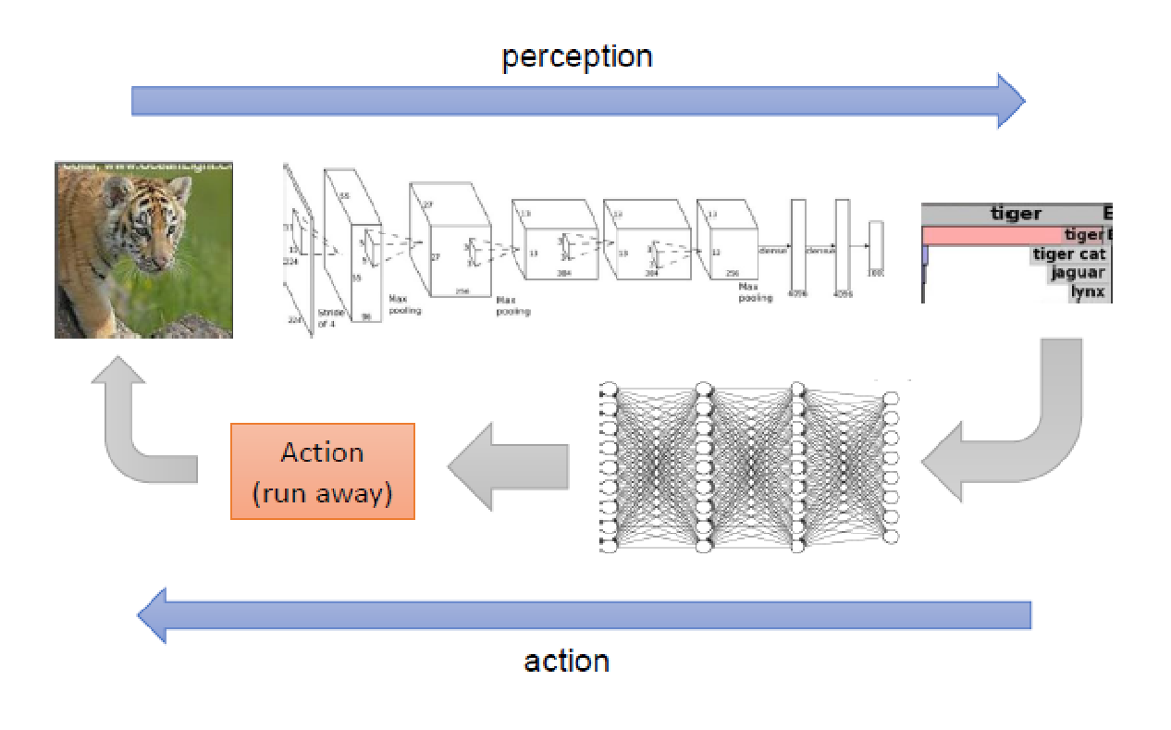
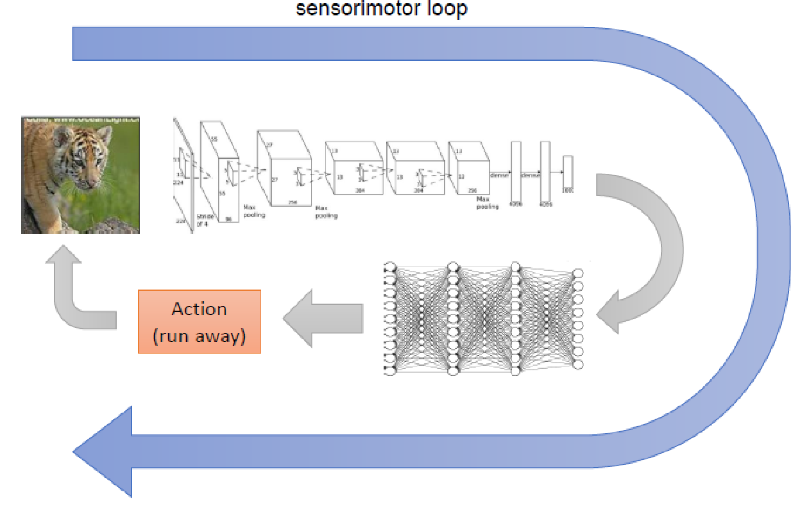
Deep
End-to-end
REVOLUTION!

Slide 10
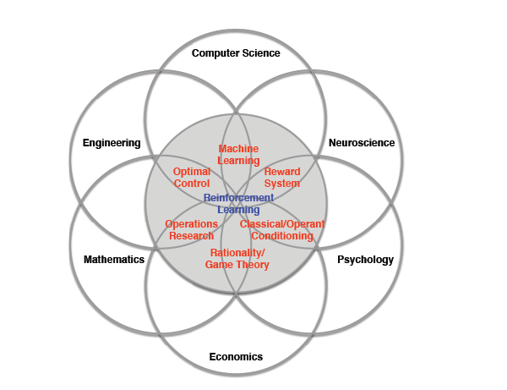
Many Faces of Reinforcement Learning
Tutorial: Deep Reinforcement Learning
David Silver, Google DeepMind

Slide 11
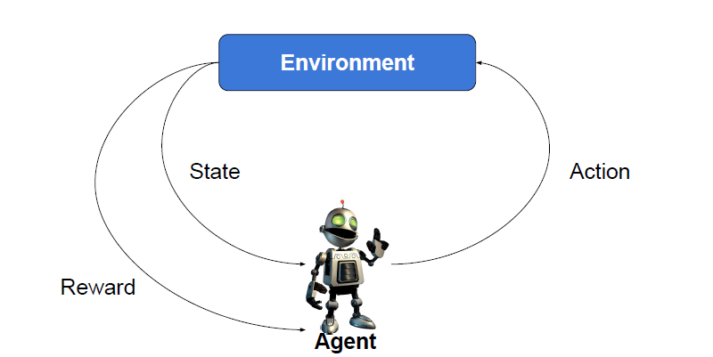
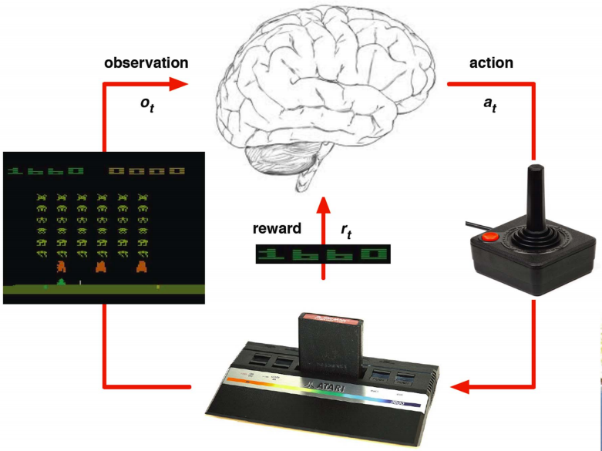
What’s Reinforcement Learning?
Agent interacts with an environment and learns by maximizing a reward.
No labels or any other supervision is given.

Slide 12
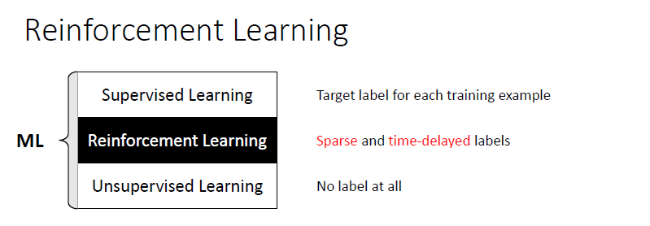

Slide 13
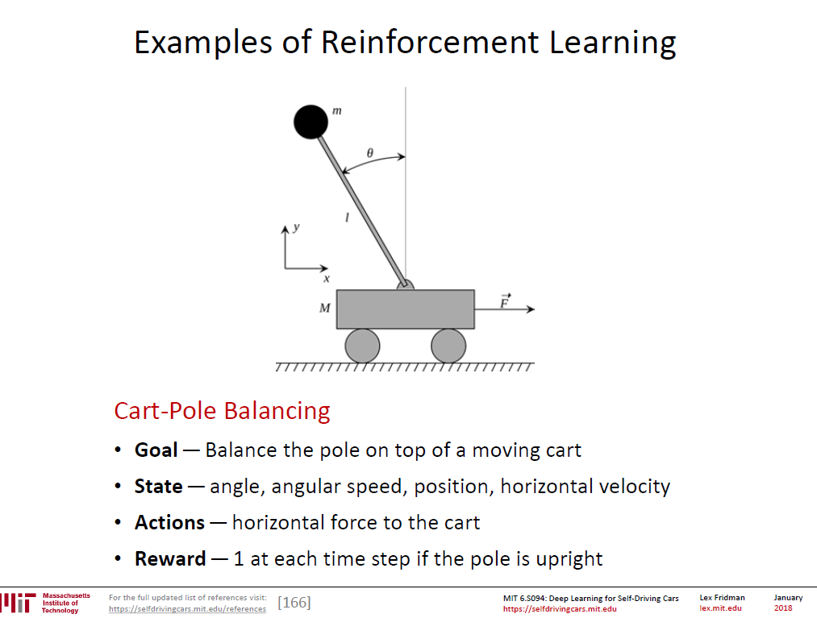

Slide 14
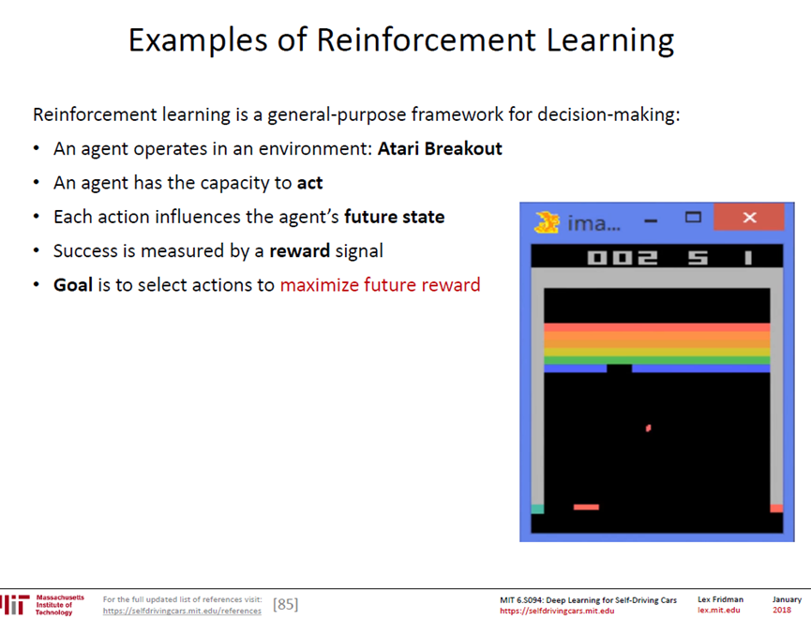
https://youtu.be/V1eYniJ0Rnk
https://www.youtube.com/watch?v=LikxFZZO2sk
https://www.youtube.com/watch?v=Aut32pR5PQA

Slide 15
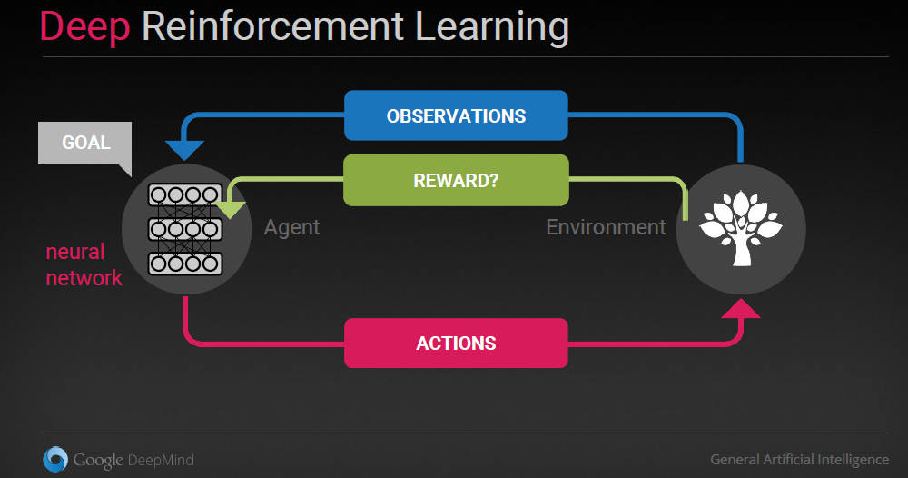
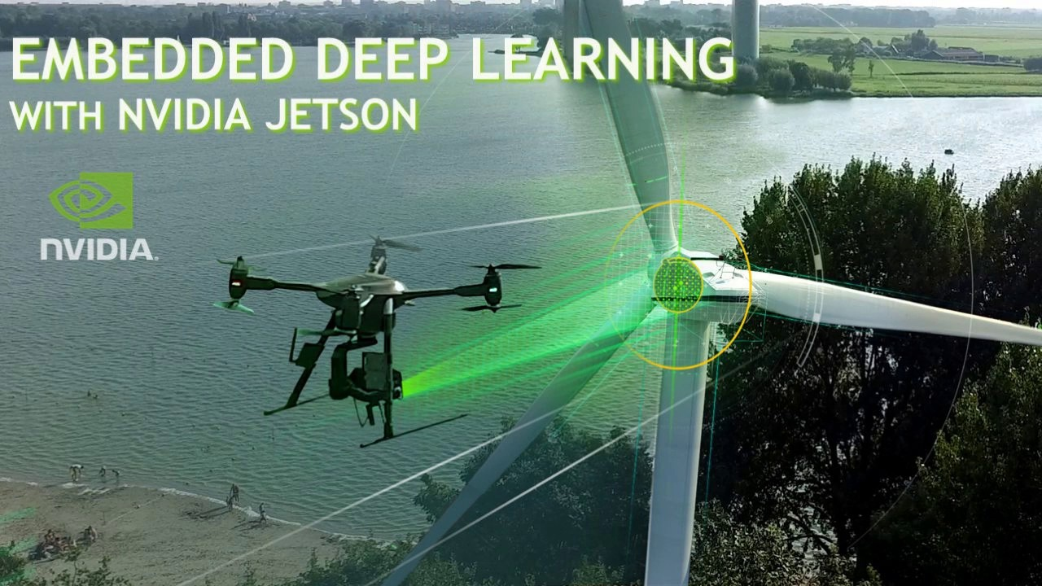
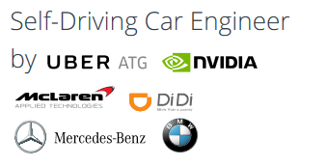
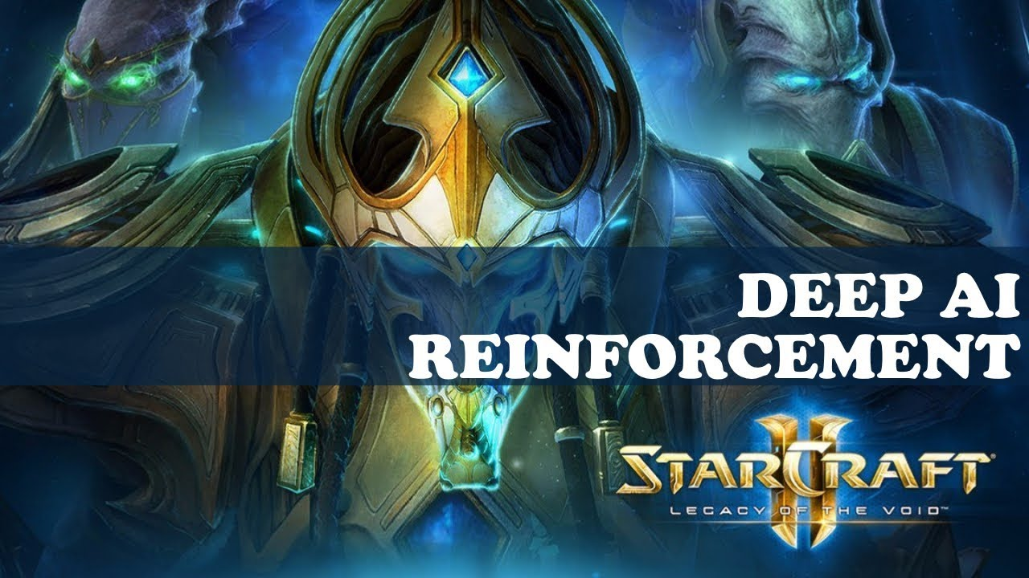


Slide 16
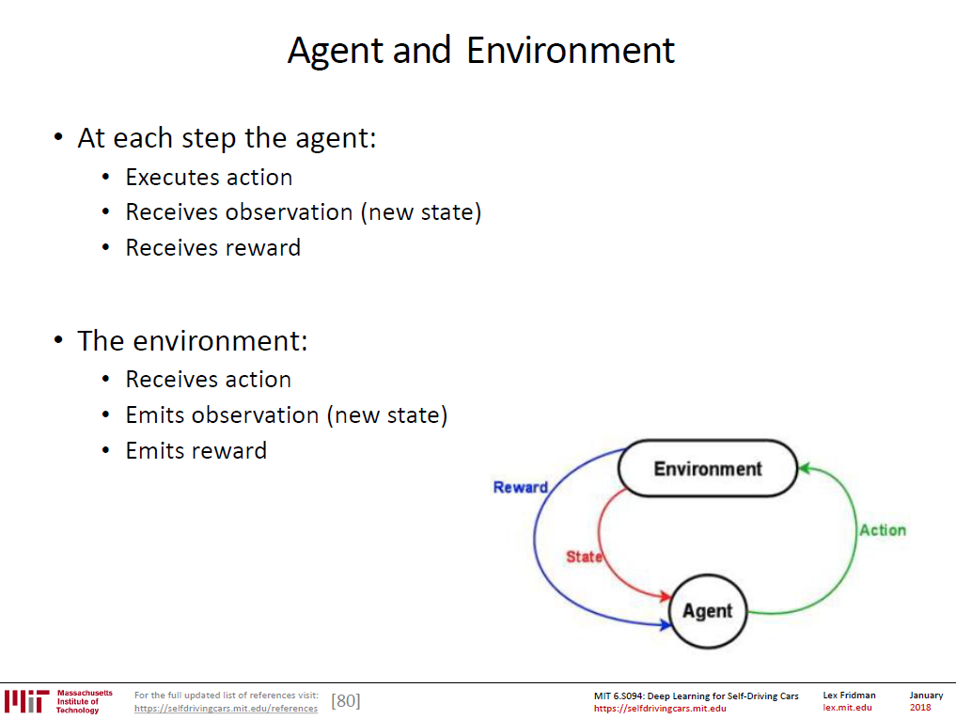

Slide 17
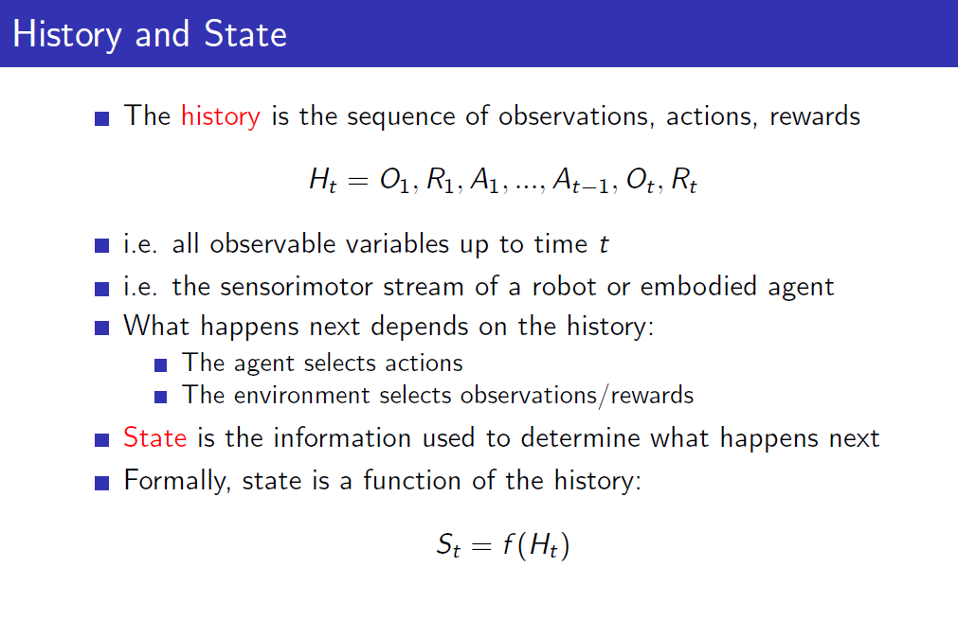
Introduction to RL by David Silver http://www0.cs.ucl.ac.uk/staff/d.silver/web/Teaching_files/intro_RL.pdf

Slide 18
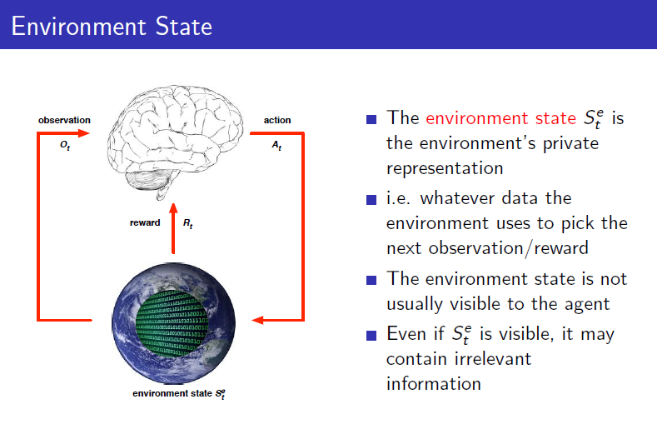
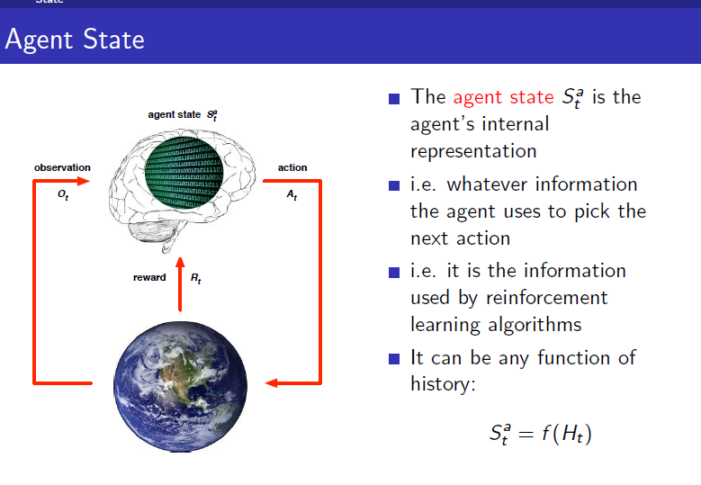
Introduction to RL by David Silver http://www0.cs.ucl.ac.uk/staff/d.silver/web/Teaching_files/intro_RL.pdf

Slide 19
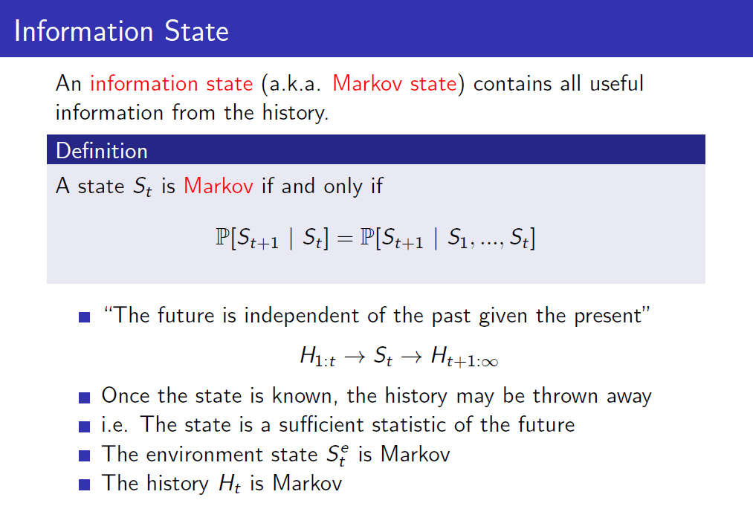
Introduction to RL by David Silver http://www0.cs.ucl.ac.uk/staff/d.silver/web/Teaching_files/intro_RL.pdf

Slide 20
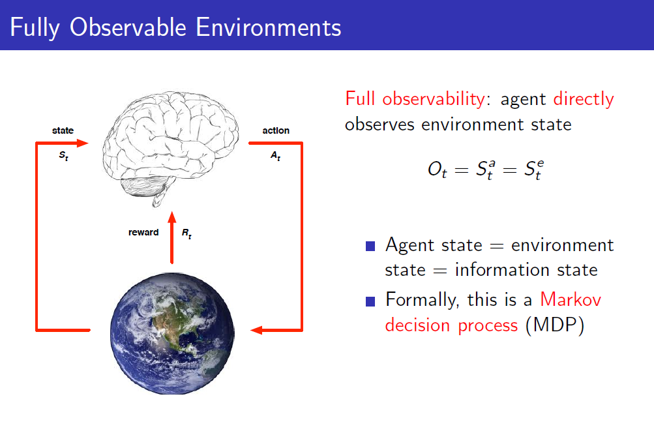
Introduction to RL by David Silver http://www0.cs.ucl.ac.uk/staff/d.silver/web/Teaching_files/intro_RL.pdf

Slide 21
From simple to complex scenarios
The single agent problem. Model known
The single agent problem. Model unknown
The multi agent problem. Game Theory
Learning in multi agent scenarios

Slide 22
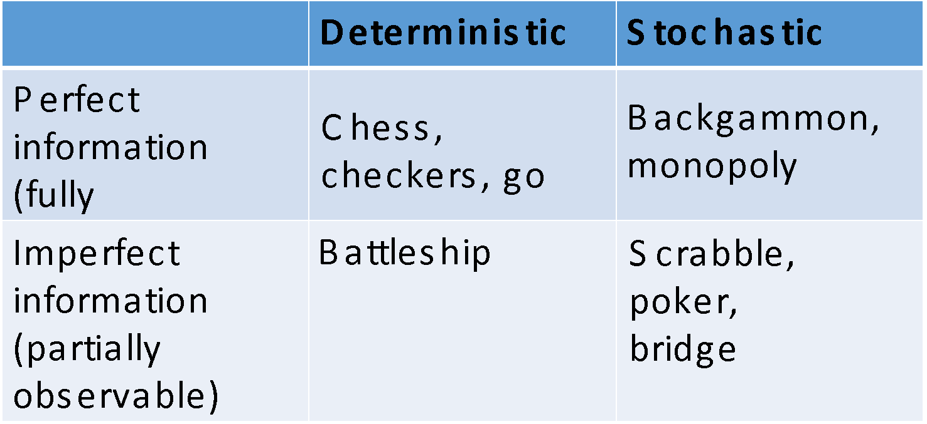
Types of games environments

Slide 23
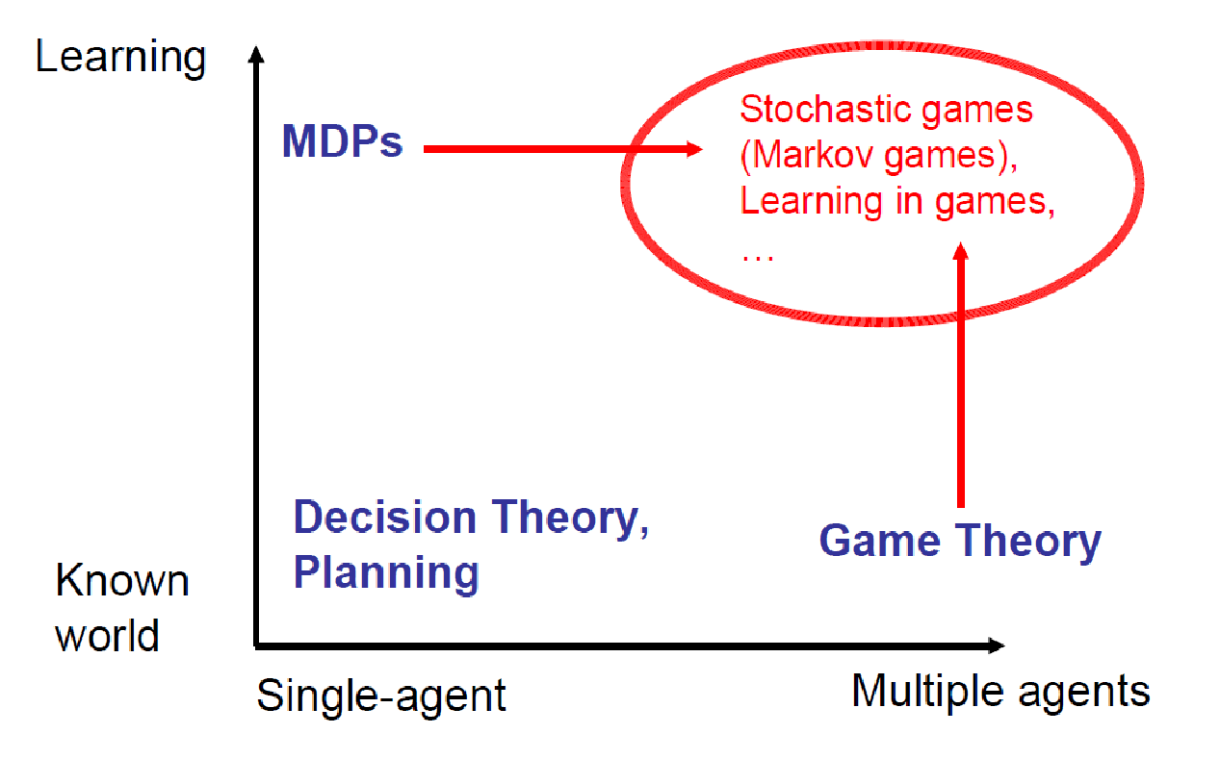

Slide 24
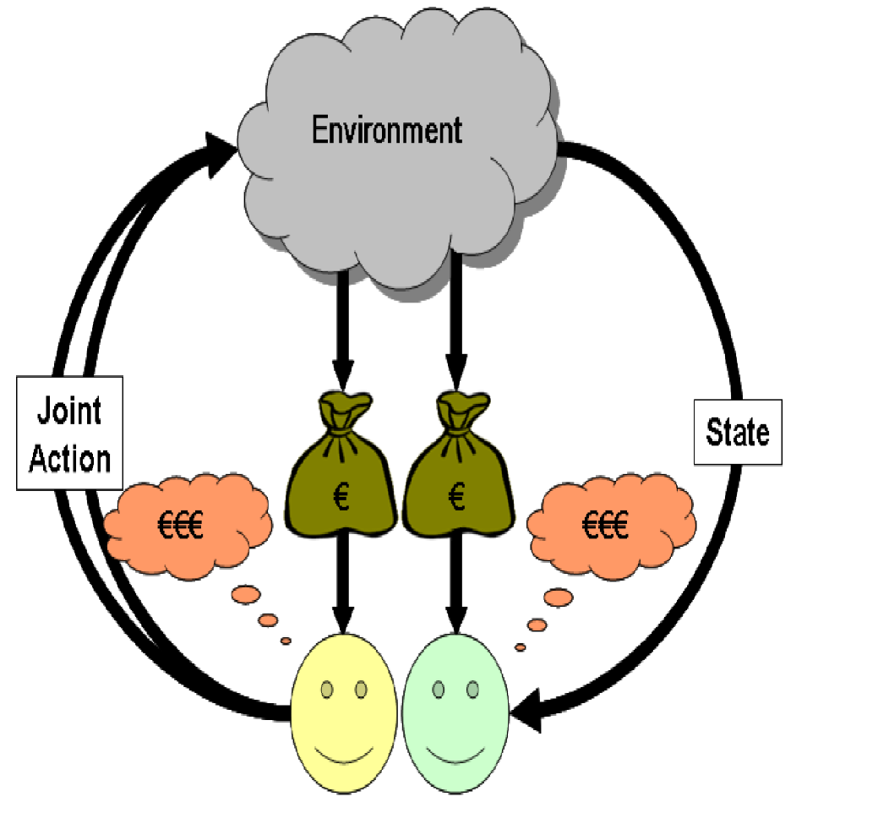
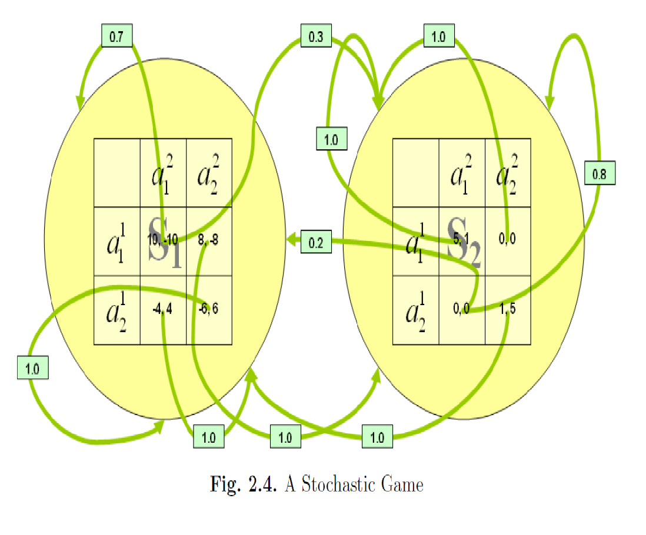
Multi Agent learning.

Slide 25
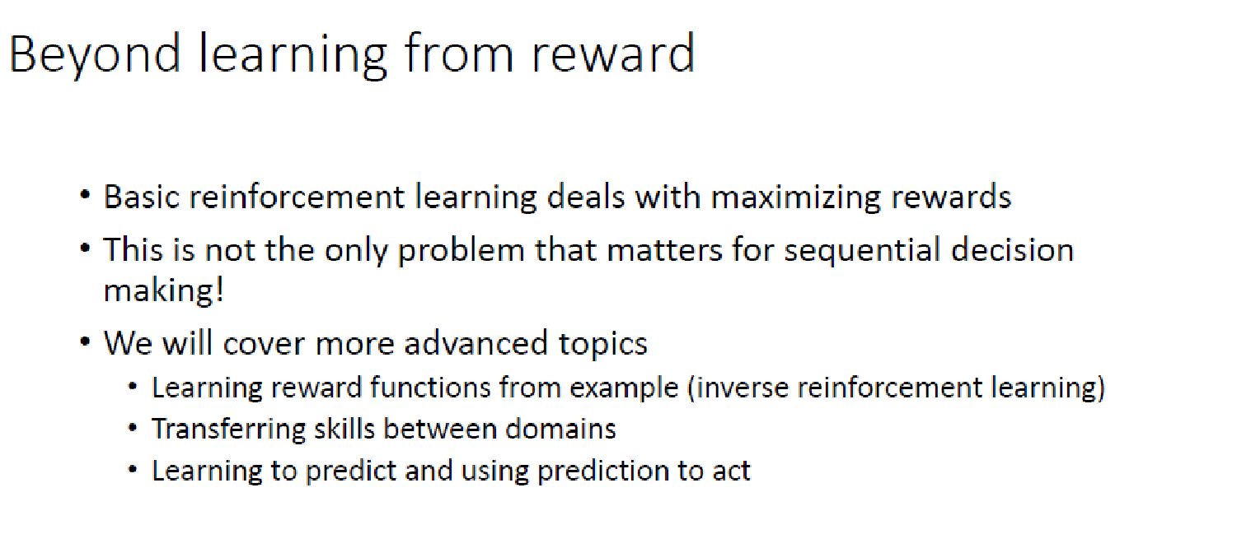
Second Semester MSTC Course on Reinforcement Learning
(Prof. Santiago Zazo)

Slide 26
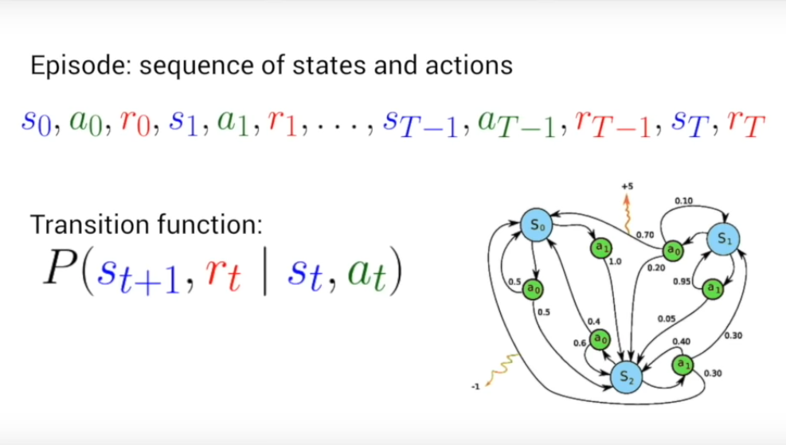
MDP: Markov Decision Process
Harini Suresh.MIT 6.S191 Lecture 6: Deep Reinforcement Learning https://www.youtube.com/watch?v=xWe58WGWmlk&t=362s

Slide 27
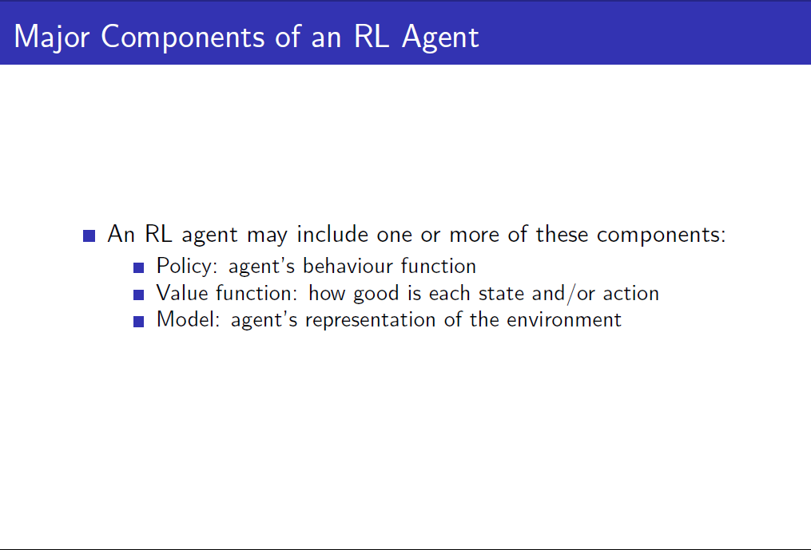
Introduction to RL by David Silver http://www0.cs.ucl.ac.uk/staff/d.silver/web/Teaching_files/intro_RL.pdf

Slide 28
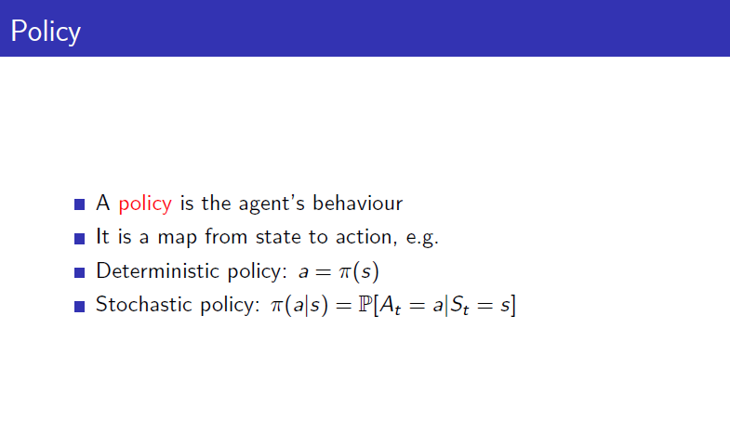
Introduction to RL by David Silver http://www0.cs.ucl.ac.uk/staff/d.silver/web/Teaching_files/intro_RL.pdf

Slide 29
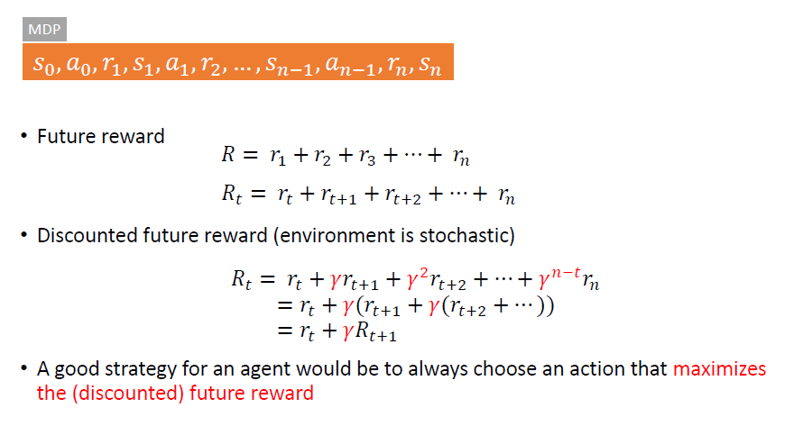
Reward

Slide 30
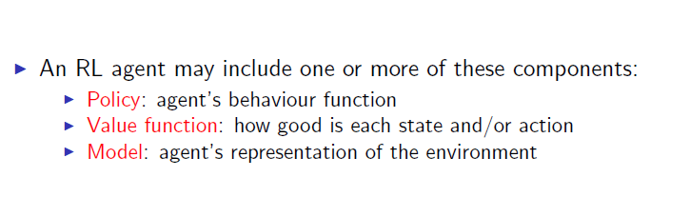
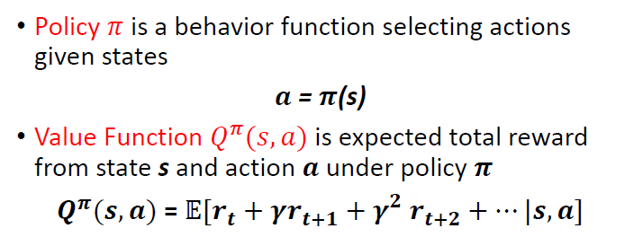
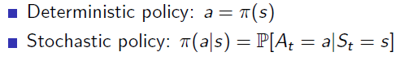
Major Components of an RL Agent

Slide 31
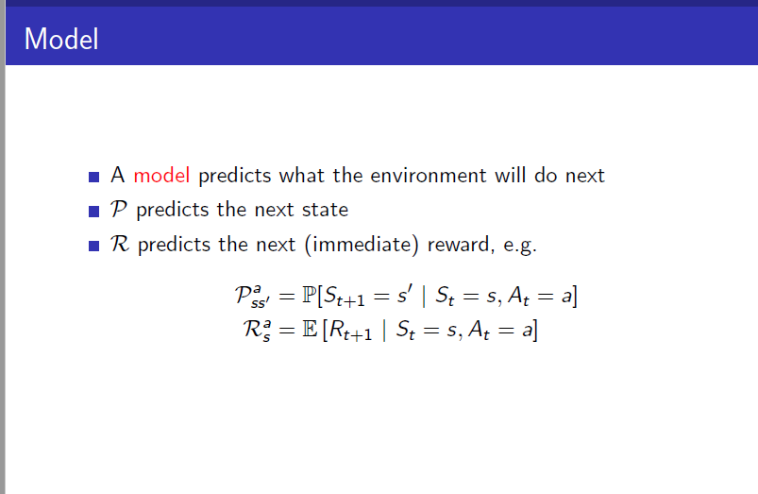
Introduction to RL by David Silver http://www0.cs.ucl.ac.uk/staff/d.silver/web/Teaching_files/intro_RL.pdf

Slide 32
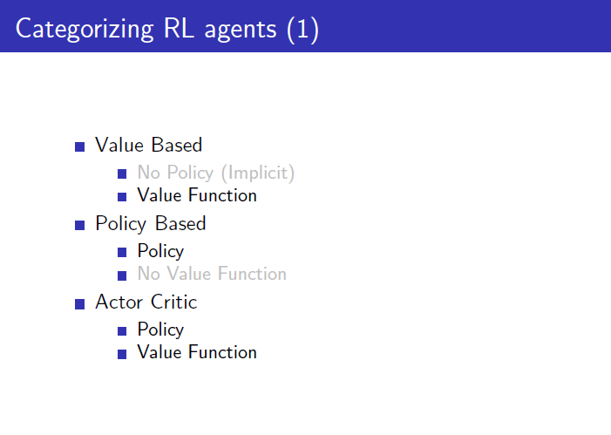
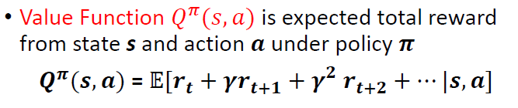
Introduction to RL by David Silver http://www0.cs.ucl.ac.uk/staff/d.silver/web/Teaching_files/intro_RL.pdf

Slide 33
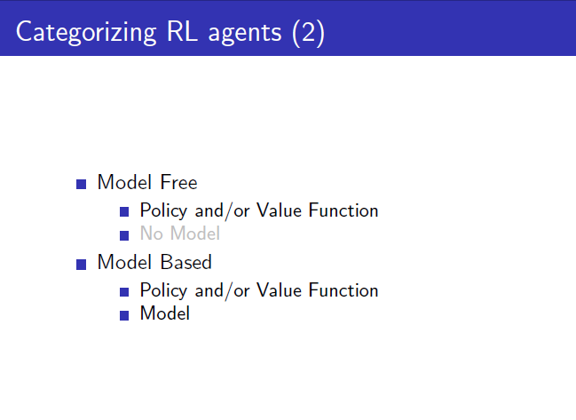
Introduction to RL by David Silver http://www0.cs.ucl.ac.uk/staff/d.silver/web/Teaching_files/intro_RL.pdf

Slide 34
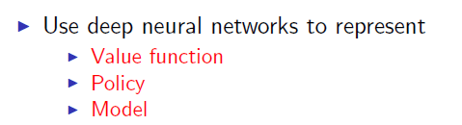
Deep Reinforcement Learning (in a nutshell)

Slide 35
In this Intro we will only approach to:
DQN : Deep Q-learning

Slide 36
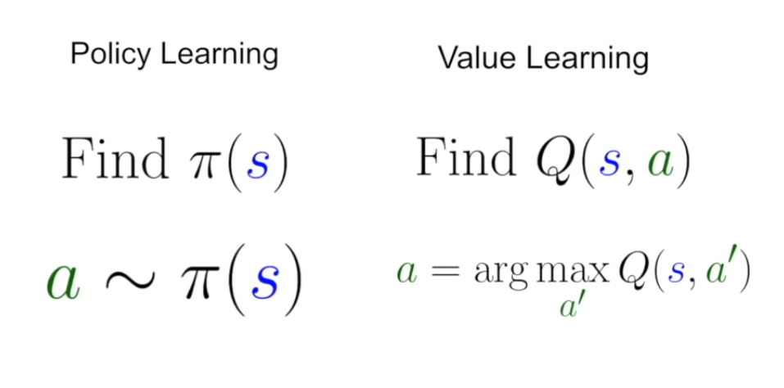
Harini Suresh.MIT 6.S191 Lecture 6: Deep Reinforcement Learning https://www.youtube.com/watch?v=xWe58WGWmlk&t=362s

Slide 37
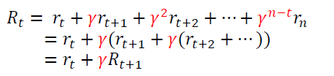
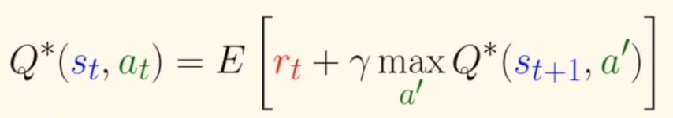

Slide 38
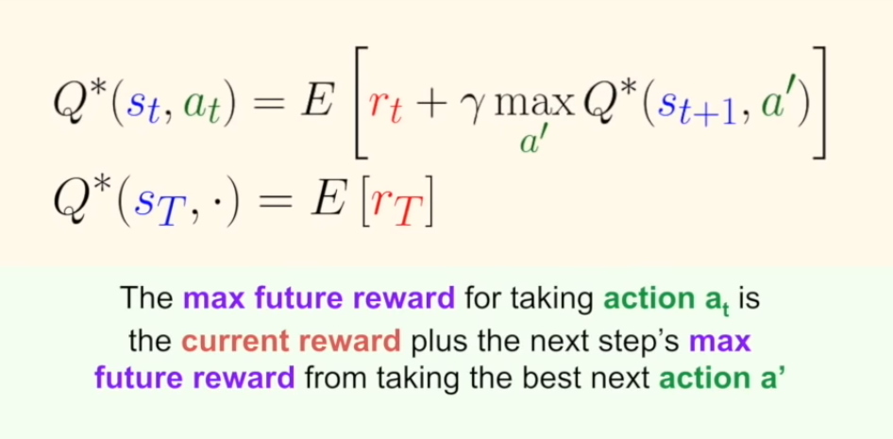
Bellman Equation
Harini Suresh.MIT 6.S191 Lecture 6: Deep Reinforcement Learning https://www.youtube.com/watch?v=xWe58WGWmlk&t=362s

Slide 39
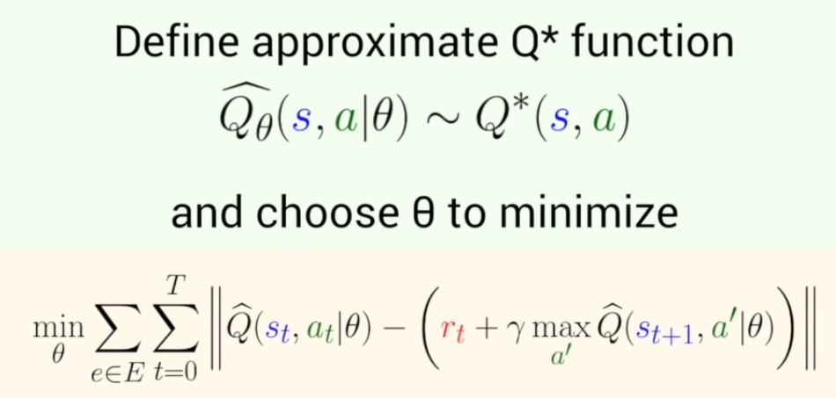
Q - learning
Harini Suresh.MIT 6.S191 Lecture 6: Deep Reinforcement Learning https://www.youtube.com/watch?v=xWe58WGWmlk&t=362s

Slide 40
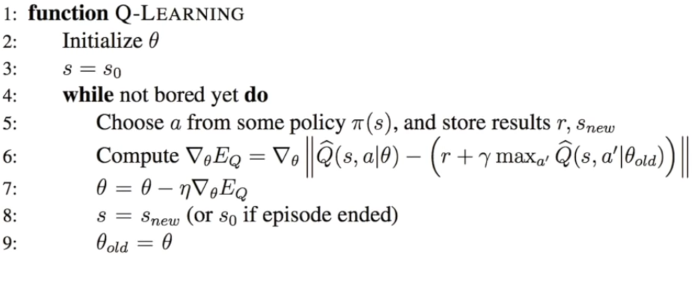
Harini Suresh.MIT 6.S191 Lecture 6: Deep Reinforcement Learning https://www.youtube.com/watch?v=xWe58WGWmlk&t=362s

Slide 41
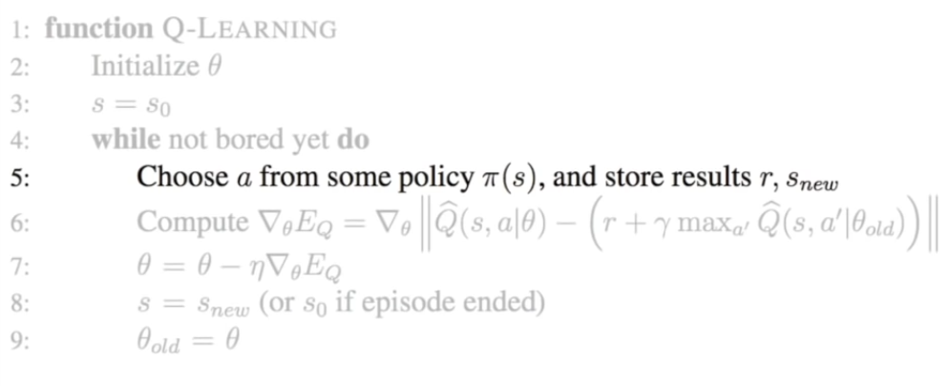
Harini Suresh.MIT 6.S191 Lecture 6: Deep Reinforcement Learning https://www.youtube.com/watch?v=xWe58WGWmlk&t=362s

Slide 42
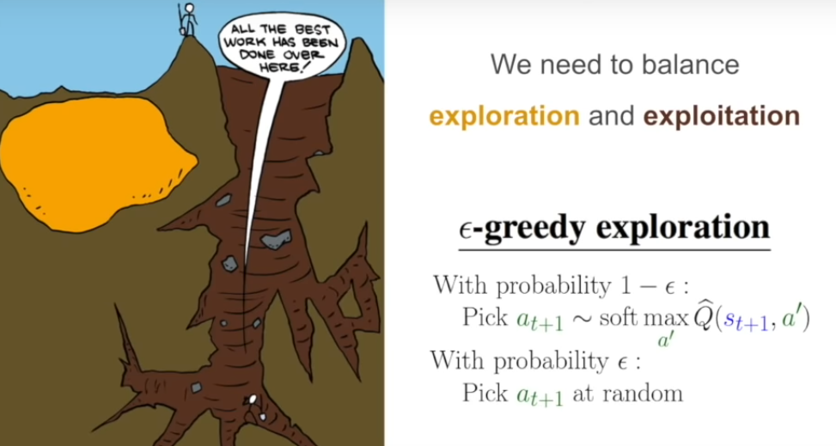
Harini Suresh.MIT 6.S191 Lecture 6: Deep Reinforcement Learning https://www.youtube.com/watch?v=xWe58WGWmlk&t=362s

Slide 43
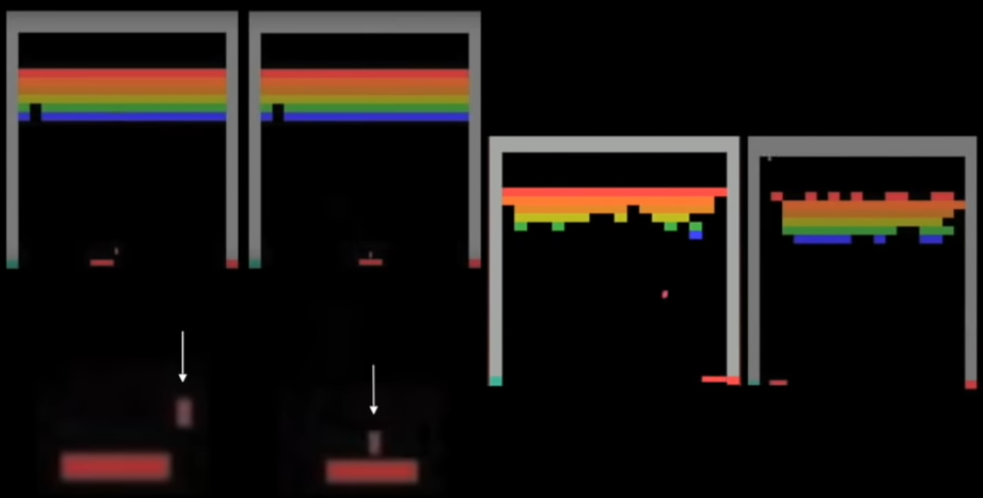
Harini Suresh.MIT 6.S191 Lecture 6: Deep Reinforcement Learning https://www.youtube.com/watch?v=xWe58WGWmlk&t=362s

Slide 44
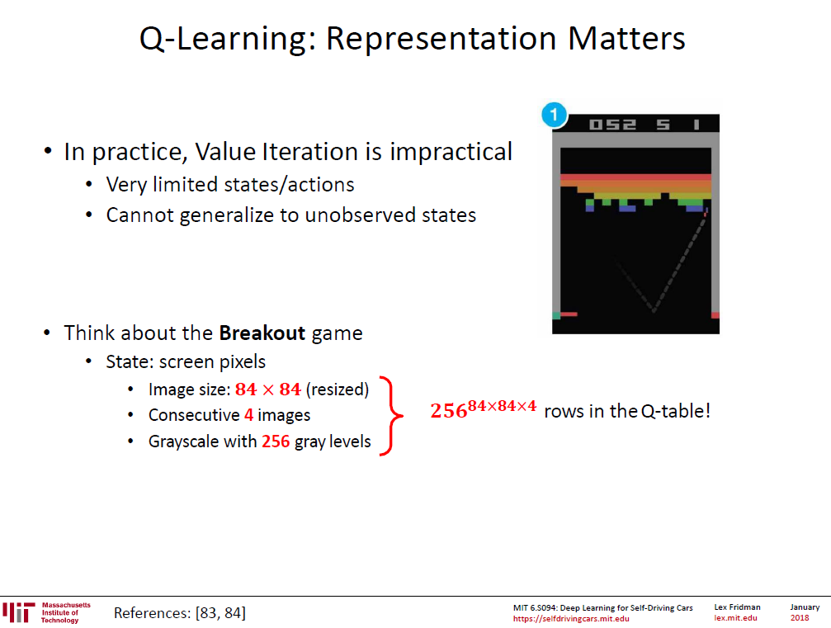

Slide 45
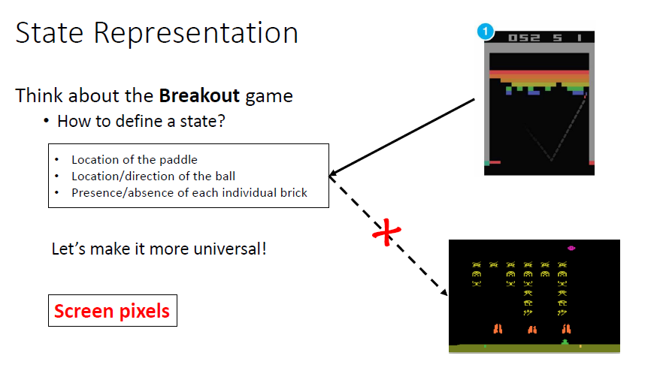
Universal approach!

Slide 46

Example: Deep Q Learning (in Atari)

Slide 47

DQN in Atari
End-to-end learning of values Q(s, a) from pixels
Input state s is stack of raw pixels from last 4 frames
Output is Q(s, a) for 18 joystick/button positions
Reward is the change in the score for that step
Mnih, Volodymyr, et al. 2015.

Slide 48

Reading:
https://web.stanford.edu/class/psych209/Readings/MnihEtAlHassibis15NatureControlDeepRL.pdf
Human-level control through deep reinforcement learning
Volodymyr Mnih, Koray Kavukcuoglu, David Silver, Andrei A. Rusu, Joel Veness, Marc G. Bellemare, Alex Graves, Martin Riedmiller, Andreas K. Fidjeland, Georg Ostrovski, Stig Petersen, Charles Beattie, Amir Sadik, Ioannis Antonoglou, Helen King, Dharshan Kumaran, Daan Wierstra, Shane Legg & Demis Hassabis
Nature volume 518, pages 529–533 (26 February 2015)

Slide 49
Editorial Summary
Self-taught AI agent masters Atari arcade games
For an artificial agent to be considered truly intelligent it needs to excel at a variety of tasks considered challenging for humans.
To date, it has only been possible … to master a single discipline for example, IBM's Deep Blue beat the human world champion at chess…
Now a team working at Google's DeepMind subsidiary has developed an artificial agent dubbed a deep Q-network that learns to play 49 classic Atari 2600 'arcade' games directly from sensory experience, achieving performance on a par with that of an expert human player.
By combining…..

Slide 50
By combining:
Reinforcement Learning: selecting actions that maximize reward in this case the game score
with Deep Learning: multilayered feature extraction from high-dimensional data in this case the pixels
the game-playing agent takes artificial intelligence a step nearer the goal of systems capable of learning a diversity of challenging tasks from scratch.

Slide 51


Slide 52

Use a different output for
Each possible action

Slide 53


Slide 54


Slide 55


Slide 56


Slide 57


Slide 58


Slide 59

Massively Parallel Methods for Deep Reinforcement Learning
Google Deep Mind (2015)
https://arxiv.org/pdf/1507.04296.pdf

Slide 60
MSTC_RL_QDN_Atari.ipynb
# Process a new observation and feed it into "agent.run" that:
# 1.- appends it to a new state
# 2.- stores it into REPLAY MEMORY
# 3.- IF "replay memory" larger that NUM_REPLAY_MEMORY trains the "training network"
# 4.- AFTER a number of steps (TARGET_UPDATE_INTERVAL) the Q network is updated
# 5.- SAVE NETWORK every SAVE_INTERVAL intervals

Slide 61


Slide 62


Slide 63


Hands-on practice!
There is a large number of environments

Slide 64
Environment libraries
OpenAI Roboschool: Robot simulation
OpenAI Universe: gym on VNC servers inside docker containers
Intel Nervana Coach: Environments + DLR algorithms
Deepmind Lab:
Deepmind Pysc2: Star Craft 2 - like environments

Slide 65


Gema Parreño
Startcraft_pysc2_minigames
https://www.youtube.com/watch?v=Xq_8WTiWb2M

Slide 66
The problems with Q-learning:
Restrictive Assumptions
Handles long horizons poorly
Requires a simulator
Harini Suresh.MIT 6.S191 Lecture 6: Deep Reinforcement Learning https://www.youtube.com/watch?v=xWe58WGWmlk&t=362s

Slide 67


